Slide 1
Java Trouble Shooting

Slide 2
Agenda
JVM
Options
JMV Structure
GC
Algo
Collectors
Multi-threading
Thread pool
Fork/Join
CompletaleFuture
Monitoring/Testing
jconsole
Jvisualvm
Jmeter

Slide 3
Case study
某市创办“E商圈分销网”欲为全市传统销售商建立统一网上分销接口，形式类似于淘宝网店。为了给销售商提供可定制的页面，项目一期采用了动态生成JSP页面的方式，根据销售商设置的功能不同，为每个销售商生成一组独立的JSP页面。试运行初期未出现问题，但销售商数量增加到一定数量后，系统经常会崩溃；当进一步增加销售商，服务器甚至会在启动时即报OOM异常。
加入-XX:+HeapDumpOnOutOfMemoryError参数，得到boon.hprof
增加-Xmx未明显减轻症状
请根据以上症状分析原因，并给出解决方案

Slide 4
Where is JVM
Are they JVM?
%JAVA_HOME%\bin\java.exe
%JAVA_HOME%\bin\javaw.exe
%JAVA_HOME%\bin\javaws.exe
It’s here
%JAVA_HOME%\jre\bin\server\jvm.dll
JVM launcher
Notes:
javaw: java windowed, W/O console for error/output
javaws: java web start

Slide 5

JVM
Version
JVM execution modes:
Compiled: force to do immediate JIT for all Classes.
Interpreted: compile into .class then interpret into machine code.
Mixed: compile into .class and use JIT in runtime.
Notes:
JIT: monitor methods, when meeting some criteria, then it’s a ‘hot method’ and optimization is scheduled to compile it into machine codes (in separate thread)

Slide 6
HotSpot VM options
Standard
Eg: -classpath, -version …
Non-Standard
Check → java -X
Eg: -Xms, –Xmx, -Xint
XX options
Check → java -XX:+PrintFlagsFinal -version
Boolean option
-XX:+<option>, -XX:-<option> (-XX:+PrintGCDetails)
Value options
-XX:<option>=<value> (-XX:NewSize=2m)

Slide 7
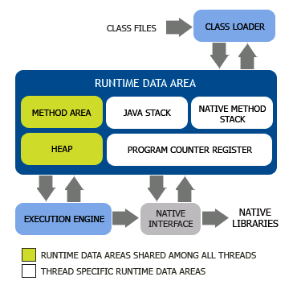
JVM Structure
Runtime Data Area
Shared:
Method area
Heap
Thread-specific:
Java Stack
Native Stack
PC Register

Slide 8
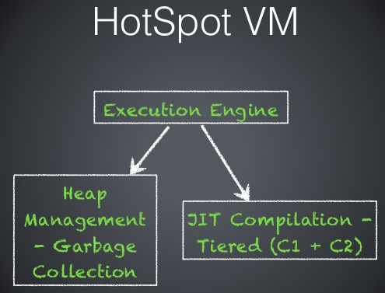
Execution engine
GC
JIT Complier
OSR (on stack replacement)
Replace function on stack frame
C1 (Client Compiler)
Lightweight, no performance monitoring, small amount of optimization, quick.
C2 (Server Compiler)
Heavy, performance monitoring, large amount of optimization, slow.
-XX:+TieredCompilation
Introduced in java7,
Turned on by default in java8
Tiered: interpreted → C1 → C2

Slide 9
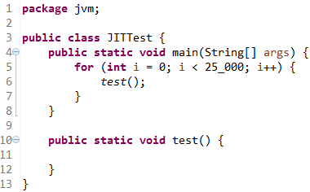


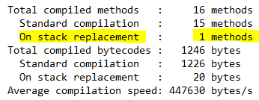
JIT
JITTest.java
Compilation log
JIT analysis

Slide 10
Threshold Policy
Identify ‘Hot’ spots
Method: Invocation counter
Loop: Back Edge counter
Method
-XX:CompilationThreshold
Loop
Formula → CompileThreshold * ( OnStackReplacePercentage – InterpreterProfilePercentage )

Slide 11
Java Stack
Java Stack
Each thread owns a Java Stack which stores local variables while executing.
Method called: push a frame into stack.
Method returned: pop a frame out of stack.
Stack Structure
Size: 512k in 32-bit machine, 1m in 64-bit machine
Notes:
Stack → assure all data in frame will be cleaned after popping …

Slide 12
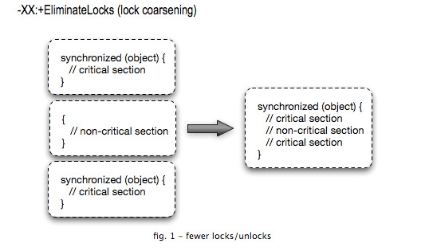
Escape Analysis
Escape Analysis is to check the scope of the object and see if they might escape away to heap. Objects that are confined can be optimized.
Escape ways
Method escape: object escape to another method as parameter.
Thread escape: if the object is shared by multiple threads.
Options
Turn on: -XX:+DoEscapeAnalysis
Synchronization elimination: -XX:+EliminateLocks (on since 1.7)
Scalar Replacement: -XX:+EliminateAllocations (on since 1.7)
Notes:
Stack allocation is much faster than heap allocation
Optimization approaches → -XX:+EliminateLocks, -EliminateAllocations,
Jmap check objects in heap
http://www.jianshu.com/p/20bd2e9b1f03

Slide 13

Heap
Heap
Shared among all threads.
Heap is reclaimed by an automatic storage management system.
Heap size will be dynamically expended/contracted from min to max.
TLAB
Thread Local Allocation Buffer which belongs to thread, new objects will be allocated here, for more space from Eden, synchronization needed then.
Options
-Xms64m -Xmx512m
-XX:InitialHeapSize=64m -XX:MaxHeapSize=512m
Notes:
new → need to ensure 2 threads not using same memory, if buffer is full, need another synchronized operation to apply memory from Eden

Slide 14
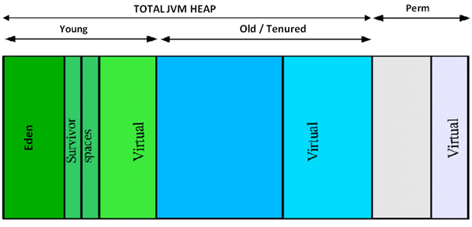
Heap
Allocate memory to Heap
32-bit → 4G
64-bit → xx?
-XX:+UseCompressedOops
Heap Generation
Notes:
UseCompressedOops : compress the object pointer, otherwise, they will consume a lot of CPU cache rigister
分代内存

Slide 15
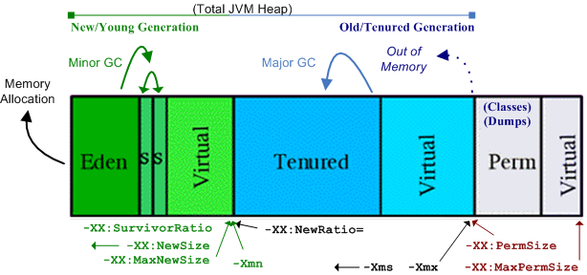

Heap
Heap Generation
Heap → -Xms30m –Xmx100m
New → -XX:NewRatio=2 -XX:SurvivorRatio=8 -XX:NewSize
Old→ –XX:OldSize
Perm → -XX:PermSize=20m –XX:MaxPermSize=60m
New to Old:
Big Object → -XX:PretenuredSizeThreshold
Old Object → -XX:MaxTenuringThreshold
Notes:
GC → minor GC → major GC → Full GC
If set ratio and abs values at the same time, use abs values.

Slide 16
Perm Gen/Metaspace
Perm Gen
Permanent generation stores long-lived objects such as .Class objects
Only Full GC will clean this area.
Disable GC for .class → -Xnoclassgc
Metaspace
Introduce in java 8, to replace Perm Gen.
Metaspace use operating system memory directly.
-XX:MetaspaceSize=20m –XX:MaxMetaspaceSize=100m

Slide 17
Direct Memory
Direct Memory is the system memory which not belong to ‘Runtime Data Areas’ and not would be cleaned ONLY via Full GC.
How to allocate
sun.misc.Unsafe.allocateMemory()
java.nio.ByteBuffer.allocateDirect();
Option
-XX:MaxDirectMemorySize

Slide 18
Garbage Collection
Garbage is the memory no longer used.
Garbage collection
To avoid OOM
Sometimes still got OOM
GC will cause pause and use CPU which reduces the throughput.
Where?
Heap: Young, Tenured
Method Area: Perm Gen (Full GC)
Direct Memory: Full GC

Slide 19
JVM GC
GC types
Full GC: heap + meta space + direct memory, ‘STW’ to collect garbage.
Major GC: tenured area, 10 times slower than minor GC, usually with 1 minor
Minor GC: young area, fast and frequent
When?
Manual: System.gc(), Runtime.getRuntime().gc()
Auto: will be triggered automatically when memory space is not enough
Options
Turn off manual GC → -XX:+DisableExplicitGC
Concurrent GC → -XX:+ExplicitGCInvokesConcurrent (work with CMS)

Slide 20
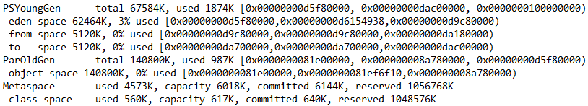
GC Logs
GC Logs
-verbose:gc
-XX:+PrintGC
-XX:+PrintGCDetails
Heap info
-Xloggc:<filename> // output gc log to file
Some ‘times’
-XX:+PrintGCDateStamps
-XX:+PrintGCApplicationConcurrentTime
-XX:+PrintGCTimeStamps
Notes:
-XX:+PrintGCDateStamps → exact time GC occur
-XX:+PrintGCTimeStamps → how many seconds since JVM start
-XX:+PrintGCApplicationConcurrentTime → application concurrent runtime when GC occur

Slide 21
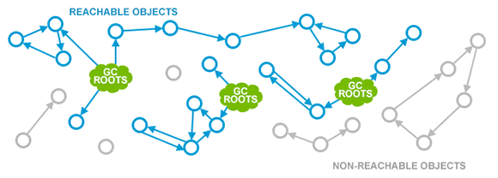
GC Algo
2 Steps
Mark: Reference Counting, GC Root Tracking
Collect: MS, Copying, MC, GC …
GC Root Tracing
Roots:
Variables in Stack
Static/Final variables

Slide 22
Reference
Reference types
Strong reference: normal references
SoftReference: (java.lang.ref.SoftReference) will be cleared before OOM
WeakReference: (java.lang.ref.WeakReference) will be cleared by any GC
PhantomReference: ??

Slide 23
Collect Algo
Mark-Sweep
Mark garbage and collect
Slow and end up with memory fragmentation

Slide 24
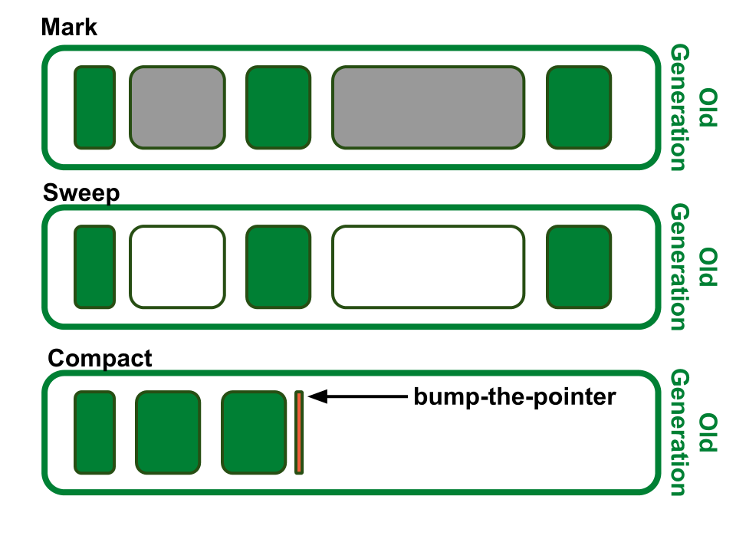
Collect Algo
Mark-Sweep-Compact
Mark garbage → sweep garbage → compact memory

Slide 25
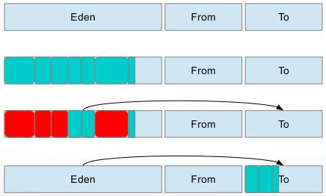
Collect Algo
Copying
Separate memory into 2 parts, copying survivors then remove garbage.
Fast, no memory fragmentation, space for time.

Slide 26
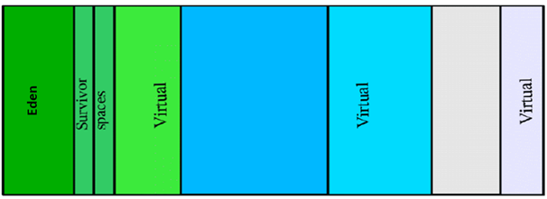
Collect Algo
Generational Collection
Memory is managed in generations with objects of different ages.
GC occur in each generation when it’s full.
Young → most objects are short-lived, so copying here.
Tenured/Perm → objects are long-lived, copying will cost too much space and work, so use Mark-Sweep(-Compact)

Slide 27
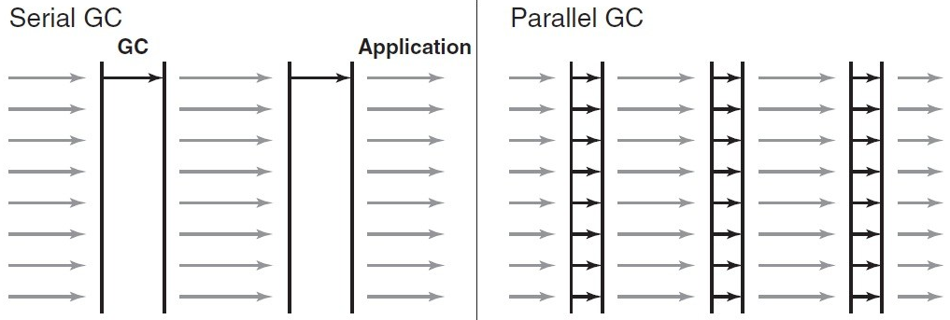
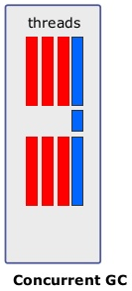
GC Parallel & Concurrent
Parallel
Multiple threads running at the same time to do GC.
Concurrent
Application threads and GC threads running at the same time.
Notes:
Parallel → user experience oriented
Concurrent → throughput oriented

Slide 28
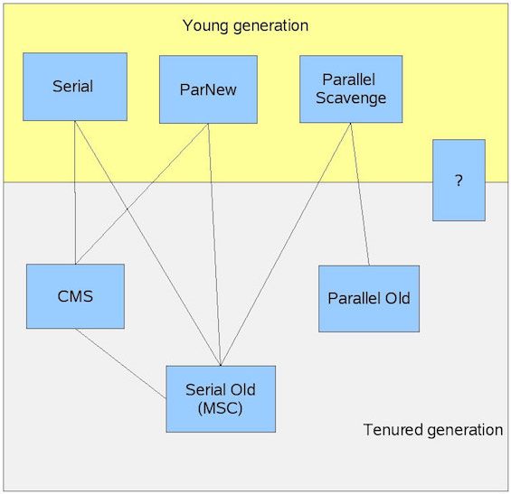
HotSpot Garbage Collectors
Parallel
Young
Serial
ParNew
Parallel Scavenge
Tenured
Serial Old
Parallel Old
CMS
Both
G1

Slide 29
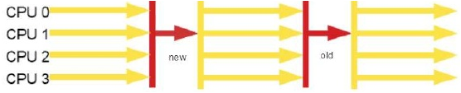
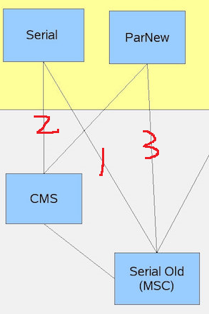
Serial
Serial
Single thread
Application thread would be paused.
Serial → Coping
Serial Old → Mark-Compact
Option
Serial + Serial Old→
-XX:+UseSerialGC
Serial + CMS →
-XX:+UseConcMarkSweepGC
-XX:-UseParNewGC
3. ParNew+ Serial Old →
-XX:+UseParNewGC

Slide 30
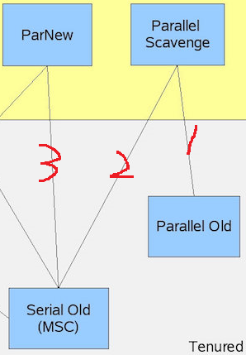
Parallel
Parallel
Multiple threads
Pause when ‘Mark’ & ‘Sweep’
Parallel Scavenge & ParNew→ Coping
Parallel Old → Mark-Compact
Option
XX:ParallelGCThreads=18
If ( cpu # > 8) → 3 + ( 5*cpu/8 )
PS young + ParOld→
-XX:+UseParallelOldGC
PS young + Serial Old →
-XX:+UseParallelGC
-XX:-UseParallelOldGC

Slide 31
Parallel
Parallel Scavenge
Young Gen collector
Copying
Goal → increase Throughput
Throughput → app time/total time == 1 – ( gc time/total time) [cpu time]
GC Ergonomics (自适应的调节策略)
Option
GC time →
-XX:MaxGCPauseMillis
( gc time/total time) →
-XX:GCTimeRatio (eg:19, (1/1+19))
GC Ergonomics →
-XX:+UseAdaptiveSizePolicy
will adapt –XX:SurvivorRatio & -XX:PretenureSizeThreshold
Notes:
GC will try its best to control max time not pass the setting …
Pause time --> if pause time is long, will decrease Eden size

Slide 32
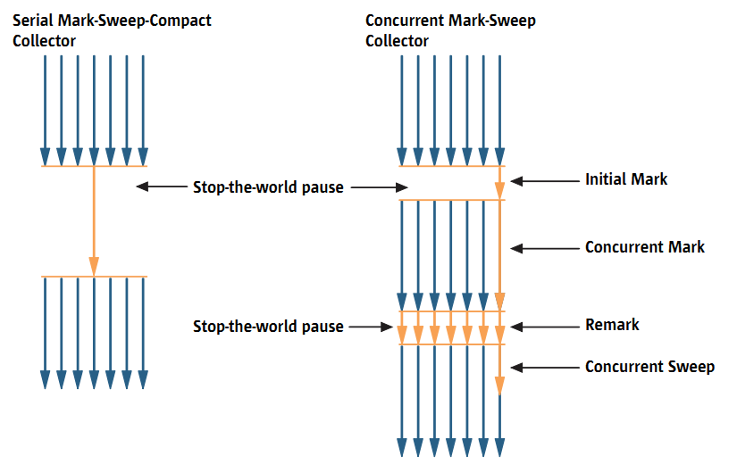
Concurrent
CMS (Concurrent Mark Sweep)
Initial Mark: find out objects directly relative reachable from the roots.
Concurrent Mark: go through root tracing
Remark: more marks which updated by app threads during previous step
Concurrent Sweep: sweep concurrently
Option
Collect Perm Gen
-XX:+CMSClassUnloadingEnabled
Parallel for initial mark
-XX:+CMSParallelInitialMarkEnabled
3. Mark & Sweep at same time →
-XX:-CMSParallelRemarkEnabled
Notes:
Other old collector will collect Perm Gen by default

Slide 33
CMS
Some Issues
Use CPU resource: impact throughput
Concurrent threads == (cores + 3)/4
Floating garbage: newly generated garbage while sweeping
-XX:CMSInitiatingOccupancyFraction, leave some space for above.
Concurrent Mode Failure: if no more space, switch to Serial Old.
Memory fragmentation
-XX:+UseCMSCompactAtFullCollection
-XX:CMSFullGCsBeforeCompaction=0
Notes:
\

Slide 34
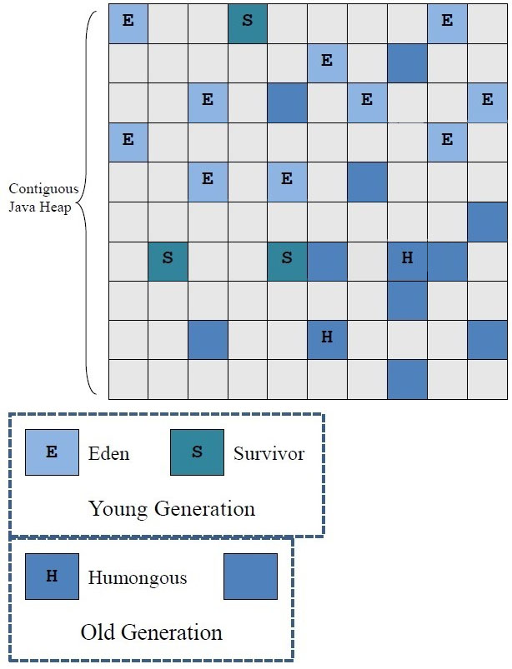
G1
G-first
Use scenario: memory size > 6G
G1 divides the heap into regions (1m-32m)
Supported size == 32m * 2000 ➔ 62.5G
-XX:G1HeapRegionSize=2m
Focus on regions with most garbage first.
Compact the heap on-the-go, no STW.
Option
-XX:+UseG1GC
Notes:
\

Slide 35
Quick test
案例分析：
某系统在运行过程中会偶发停止响应的情况，经系统工具监测发现JVM内存接近最大，而GC线程一直在运行，但内存却基本没有变化。
工程师试图添加-XX:HeapDumpOnOutOfMemoryError对内存进行Dump，但由于系统一直不会抛出OOM，致使没有dump文件生成而无法分析原因。
试根据以上描述分析原因，并给出解决方案。

Slide 36
Tools
jps: check java process
jinfo: check java process parameters
jstat: jvm statistics
jstack: threads
jmap: dump heap when running
jhat: java heap analysis tool
jconsole: cpu+heap+threads+class … (1.5)
jvisualvm: advanced jconsole + dump [heap/threads] + (1.6)
JMC:
JFR: 1.7
jcmd

Slide 37

jps
Format:
jps [options] [hostid]
Options:
-q: only process id
-m: arguments passed to main()
-l: class full name
-v: jvm parameters
-V: jvm parameters passed via flags file (-XX:Flags=<file path>)

Slide 38

jstat
Format:
jstat outputOptions vmid [interval[s|ms] [count]]
outputOptions：
-class: class loading/unloading
-compiler: JIT
-gc (gcutil, gccapacity, gcnew, gcnewcapacity)
S0C | Current survivor space 0 capacity (kB)
S1C | Current survivor space 1 capacity (kB)
S0U | Survivor space 0 utilization (kB)
S1U | Survivor space 1 utilization (kB)
EC | Current eden space capacity (kB)
EU | Eden space utilization (kB)
OC | Current old space capacity (kB)
OU | Old space utilization (kB)
MC | Metaspace capacity (kB)
MU | Metacspace utilization (kB)
CCSC | Compressed class space capacity (kB)
CCSU | Compressed class space used (kB)
YGC | Number of young generation garbage collection events
YGCT | Young generation garbage collection time
FGC | Number of full GC events
FGCT | Full garbage collection time
GCT | Total garbage collection time
Notes:
Jvm statistics
-class➔ time: total time of loading and unloading
-compiler → compiled: times of compilation tasks

Slide 39
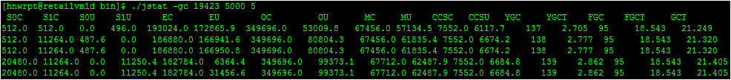
jstat
Format:
jstat vmid [interval [s|ms] [count] ]
To calculate [count] times with [interval [s|ms]]

Slide 40
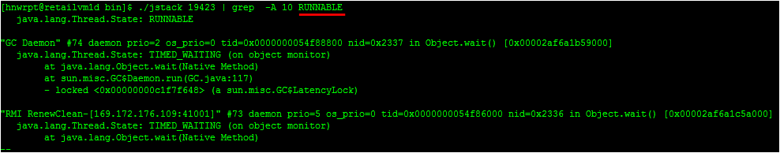
jstack
Format:
jstack [option] pid
Who use most CPU?
top + shift+h
top –p <pid>+ shift + h → <id>
printf “%x\n” <id> → to <hex>
jstack <pid> | grep –A 10 <hex>

Slide 41
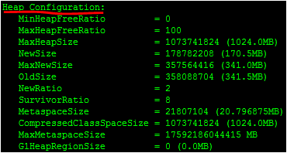
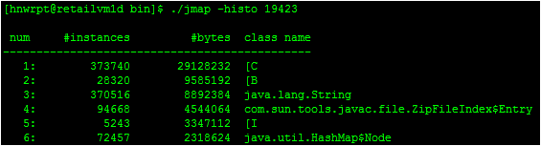

jmap
Format:
jmap –heap <pid>
- configuration & usage
jmap –histo <pid>
- object instances
jmap –dump,format=b,file=<filename> pid
- generate heap dump file

Slide 42
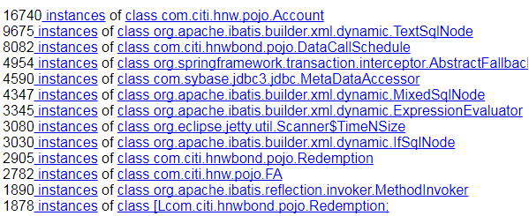
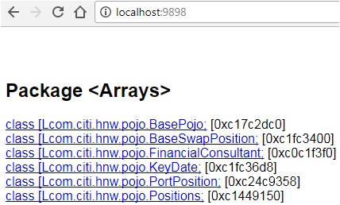
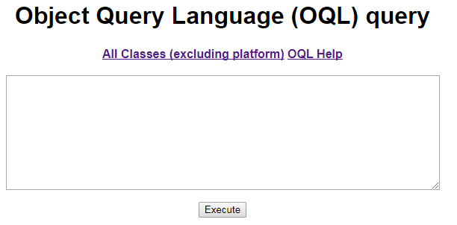
jhat
Format:
jhat –port 9898 <dump file>

Slide 43
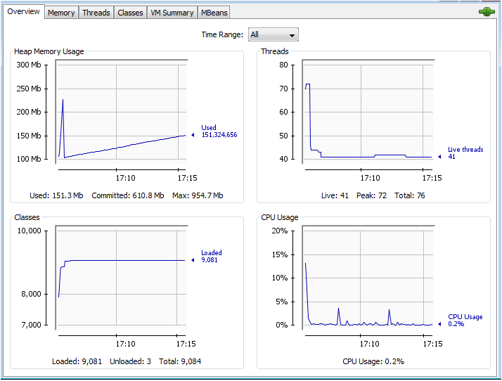
jconsole
Remote
Files (chmod 600)
jmxremote.password // test test
jmxremote.access // test readwrite
VM params
-Dcom.sun.management.jmxremote.password.file=
/opt/muni/HNWWeb/jmxremote.password
-Dcom.sun.management.jmxremote.access.file=/
opt/muni/HNWWeb/jmxremote.access
-Dcom.sun.managent.jmxremote.authenticate=true
-Dcom.sun.management.jmxremote.ssl=false
-Dcom.sun.management.jmxremote.port=8999
Notes:
http://softbeta.iteye.com/blog/1264833

